Slide 1

Cloud Adoption Framework - Ready Prepare your cloud environment with Azure landing zones
Speaker
Time
Notes:
In today’s session we'll talk about how to prepare your Azure environment with the Ready methodology of the Microsoft Cloud Adoption Framework.

Slide 2
Agenda
1
2
3
4
5
Overview of the Cloud Adoption Framework
Azure landing zones
Cloud operating model
Azure landing zone architecture
Start, Align, Enhance stages of the cloud journey

Slide 3
Cloud Adoption Framework Overview
Notes:
Let's look at the Ready methodology as part of the overall journey with the Cloud Adoption Framework.
Ref: https://docs.microsoft.com/en-us/azure/cloud-adoption-framework/overview

Slide 4
Microsoft Cloud Adoption Framework for Azure
Define strategy
Understand motivations
Business outcomes
Business justification
Prioritize project
Plan
Digital estate
Initial organization alignment
Skills readiness plan
Cloud adoption plan
Ready
Azure setup guide
First landing zone
Expand the landing zone
Best practice validation
Ready
Azure setup guide
First landing zone
Expand the landing zone
Best practice validation
Adopt
Migrate First workload migration Expanded scenarios Best practice validation Process improvements
Innovate Innovation guide Expanded scenarios Best practice validation Process improvements
Govern
Methodology
Benchmark initial best practice
Governance maturity
Manage
Business commitments
Operations baseline
Operations maturity
https://aka.ms/adopt/overview
Notes:
The Microsoft Cloud Adoption Framework aligns different phases of the cloud adoption lifecycle to ensure easy access to the right guidance at the right time.
Ready: follows the strategy and planning works. It focusses on preparing cloud environment for the planned changes.
This is a key stage of the journey, as it represents the first technical implementation stage of the adoption.
A strong starting point is crucial for a great outcome, so the core elements of the Ready methodology are key success factors.
Ready is also a jump-off point for several of the other methodologies, which rely on the strong start as fuel for their own success:
Migrate: Migrate and modernize existing workloads on the cloud.
Innovate: Develop new cloud-native or hybrid solutions.
Govern: Govern the environment and workloads to ensure industry standards and regulatory requirements.
Manage: Conduct operations management for cloud and hybrid solutions.
Let’s begin looking at what Azure landing zones are.

Slide 5
Azure landing zones
Notes:
Building on how cloud operating models define how cloud environments are used, lets now look at how we define the foundations of those environments with landing zones.
Azure landing zones are a key element of a successful cloud adoption journey as they establish the platform components that help organizations safely, and successfully migrate and innovate in the cloud.

Slide 6
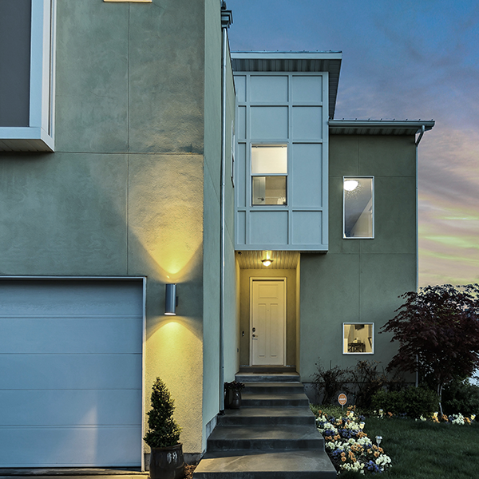
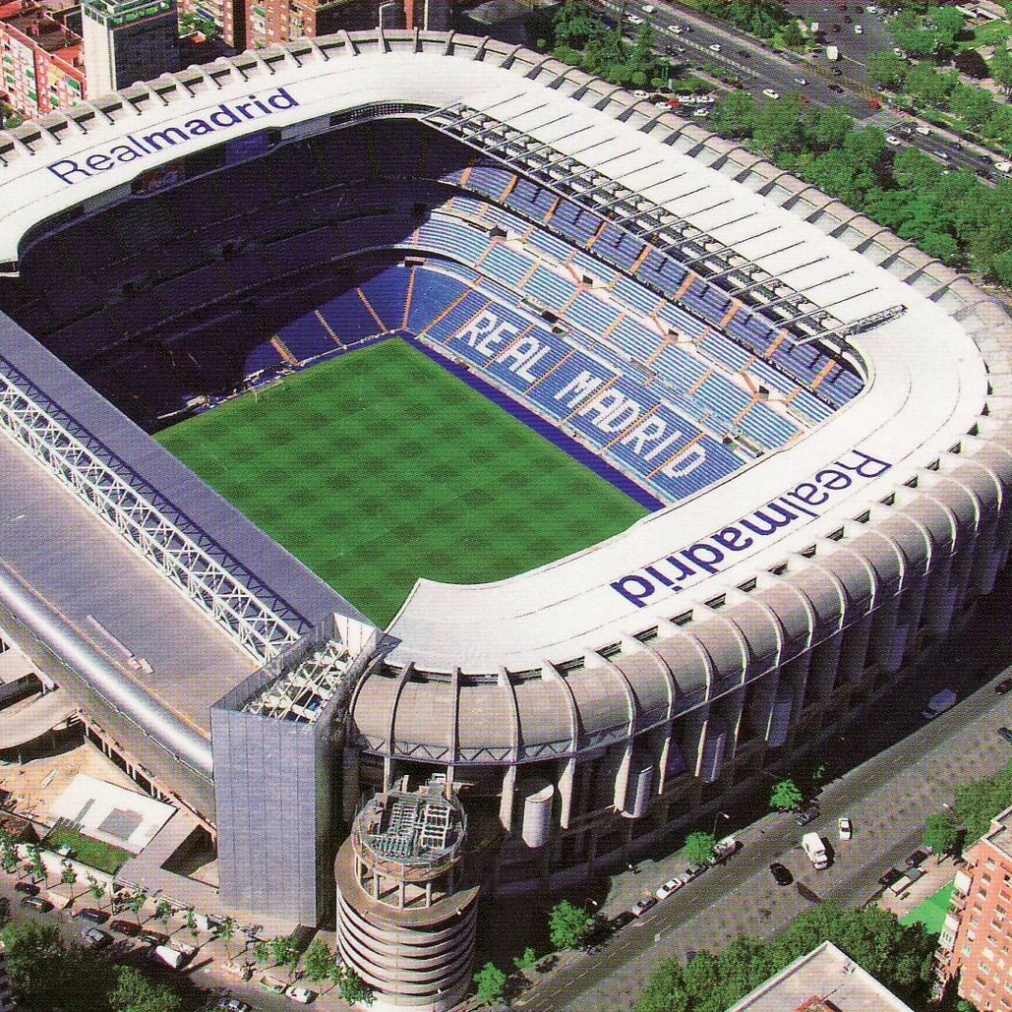

What are you building? Your cloud foundation supports the construction of a—
House
Stadium
Bridge
Notes:
Building a cloud environment like constructing a building—a house, stadium, or bridge.
The structure you’re going to build will determine your approach and architectural style.
Depending on the structure, the foundations may vary.
However, there will be common items across the various foundations.
This is also true in the cloud.
The cloud foundations may vary depending on your requirements, or the scale you need for your environment
but just like construction foundations will start with concrete and steel, cloud environments will also share common starting elements.
Which is where a landing zone comes. Let's look at what purpose they serve.

Slide 7
What are landing zones for?
Starting a journey based on best practices with a start-to-finish plan is a key factor for success
Creating well-designed foundations for a cloud environment will enable the safe adoption of new technologies, at pace
Using consistent, repeatable environment designs helps scaling out in a manageable way
Baking in repeatable best practices into environment deployments
Factoring your team's technical skills into environment planning
Notes:
A landing zone is intended to help start an environment build from strong foundations.
Best practices
Repeatable to ensure standardization
Consider technical skills of the team and their learning plans as part of the decisions you take in planning your landing zone.
Let's look at the benefits landing zones can provide for your organization.

Slide 8
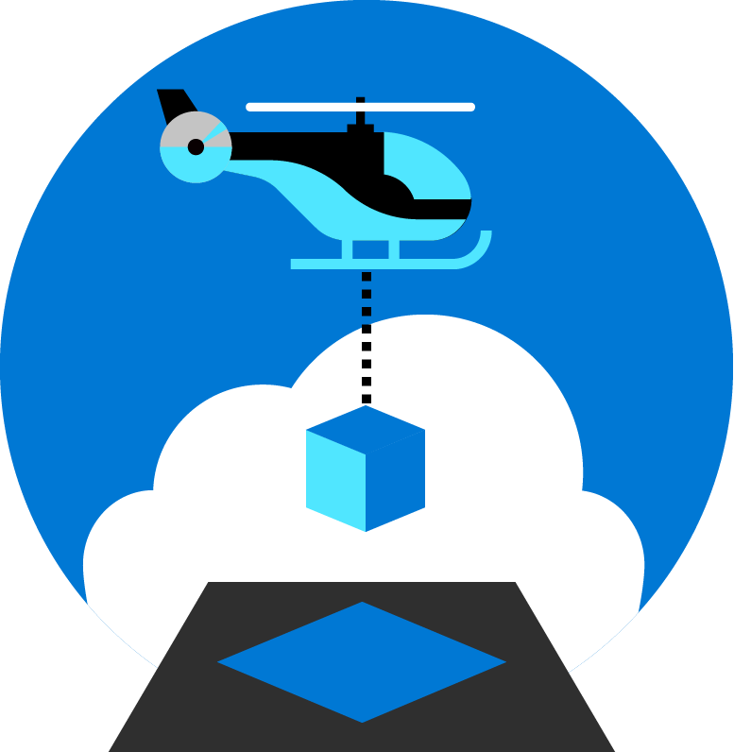
Azure landing zones
Set up Azure environments— for scale, security, governance, networking, and identity
Enable migrations and net new apps
Consider all platform resources
Don't differentiate between IaaS or PaaS
Notes:
Azure landing zones focus on unifying technologies and technical guidance to help you build a successful cloud environment.
In general, Azure landing zones:
Offer repeatable packaged environments
Enable migrations and net new apps.
Simplify the process of starting a cloud environment, to enable teams to focus on migration or innovation
Now, lets look in detail at what we consider to be the focus areas for a landing zone.

Slide 9

Azure landing zones Design areas
Azure billing & Azure Active Directory tenant
Security
Identity & access management
Governance
ENVIRONMENT
COMPLIANCE
Resource organization
Management
Network topology & connectivity
Platform automation & DevOps
Notes:
Design areas (the different parts that make up Azure landing zones) are an important early step in thinking about and designing a landing zone.
Azure billing an Active Directory tenant - Proper tenant creation, enrolment, and billing setup are important early steps.
Identity and access management - Identity and access management is a primary security boundary in the public cloud. It's the foundation for any secure and fully compliant architecture.
Resource organization - As cloud adoption scales, considerations for subscription design and management group hierarchy have an impact on governance, operations management, and adoption patterns.
Network topology and connectivity - Networking and connectivity decisions are an equally important foundational aspect of any cloud architecture.
Security - Implement controls and process to protect your cloud environments
Governance - Automate auditing and enforcement of governance policies.
Management - For stable, ongoing operations in the cloud, a management baseline is required to provide visibility, operations compliance, and protect and recover capabilities.
Platform automation and DevOps - Align the best tools and templates to deploy your landing zones and supporting resources.
Split into Environment and Compliance:
Build vs Run
Starting points vs on-going iterations and refinements
Let's look at how we approach an understanding of how a cloud operating model works.

Slide 10
Cloud operating model
Notes:
When you’re starting out on the cloud adoption journey, its important to look to the future and determine what service delivery needs to look like.
We’ve captured a few of the more common scenarios in this section that we’ll explore in more detail.

Slide 11
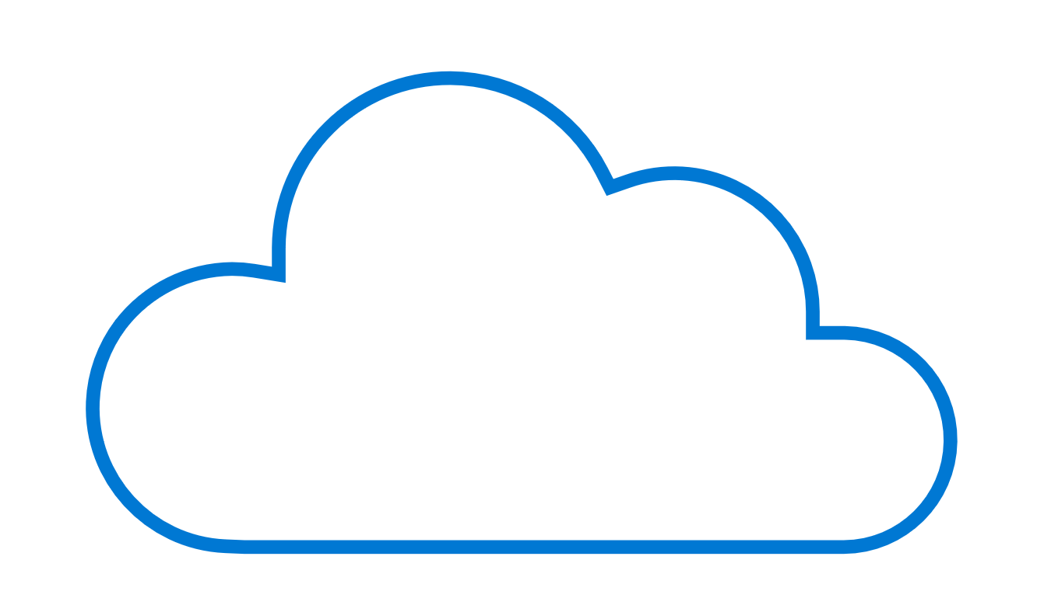
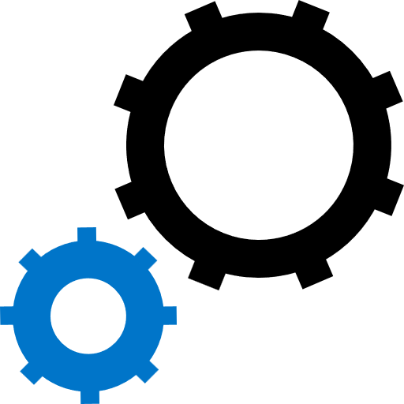


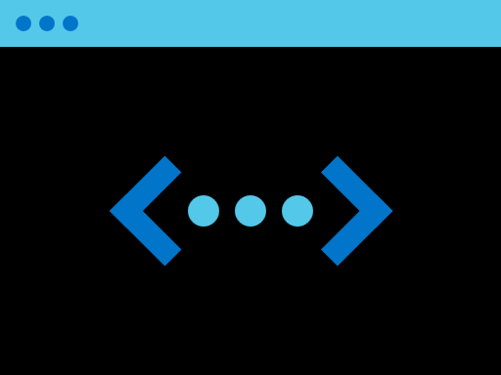
Foundations in the cloud
Workload
W
W
Assets (Resources in Azure)
Workload
Workload
W
W
W
Workload
Foundation utilities
W
W
W
W
W
Workload
Workload
Workload
Landing zone
Landing zone
Landing zone
Workload
Landing zone
Platform foundation
Foundation utilities
Notes:
When we’re thinking about our foundations in the cloud, we can look at it as:
Workload – if you’re a software company and you build an application – you’re probably going to have every environment purpose built for that application.
More commonly, a central IT team might look after the company’s infrastructure, which runs a number of workloads as well as some foundation tools and utilities in order to manage the environment and control access.
In more complex, enterprise scenarios, there may be a need to pull out the platform foundation to be pulled out and inside of that environment there may be a variety of different landing zones.
Some stable, steady-state applications may be operated by central IT. Others with higher volume of development with DevOps teams need slightly different controls or processes to maintain their delivery pace.
Let's look at how to support a different type of operating model.

Slide 12




Align the foundation— to your chosen cloud operating model
W
W
W
W
W
W
W
W
W
W
W
W
W
Distributed operations
W
W
W
W
Enterprise operations
W
W
Environmental complexity
Central operations
W
W
Workload
Landing zones
Platform foundation
Decentralized operations
Notes:
We can group those foundational structures into a handful of categories.
Decentralized operations
Fully decentralized, no central IT team, the workload team makes of the security, governance and compliance decisions on their own
Focus on WAF guidance
Central operation
Similar to central IT that you might have in a data center where you define all those rules yourself
You have to control what comes into that environment
A very ‘command and control’ mindset, focused on reducing risk, maybe at the cost of slowing down innovation
Enterprise operations
For more complex requirements, this approach helps you federate access points and separate out responsibilities – so the workload teams can make the decisions they need to, but still rely on central operations for centralized support
In this model, we’re shifting away from a command-and-control mindset into a delegated responsibility model. This is where central IT or a cloud center of excellence supports those workload teams by providing guardrails in the form of a platform foundation
rich initial implementation required to provide these capabilities
Distributed operations
And some customers that we work with – especially global customers – have more distributed operations where different geopolitical boundaries may have different types of operations.
Or in different scenarios such as - higher risk, high security or sensitive data environments you may have slightly different operations than the rest of your environments.
complex operating models
combination of operating models in one company
Environmental complexity grows as you go. Setting up your Azure environment for scale, security, governance, networking, and identity—and the right operating model that scales as you build out.
Let's look at how to find the right operating model that suits your needs.

Slide 13

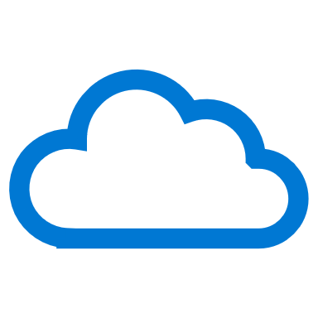

Find the operating model that fits your requirements
W
W
W
W
W
W
W
W
W
W
W
W
W
W
W
W
W
W
W
W
Decentralized operations
Central operations
Enterprise operations
Distributed operations
Which motivation is your highest strategic priority?
Innovation
Control
Democratization
Integration
What's the scope of your portfolio?
Workload
Landing zones
Cloud platform
Complex portfolio
Who’s accountable for governance, security, and operations decisions?
Workload teams
Central IT
Cloud Center of Excellence
Mix of all three or unknown
Notes:
If your highest strategic priority is innovation—decentralized operations could be a good approach
If you’re more concerned with control and reducing risk—central operations might be a good fit
If you’re trying to find that balance and you want to democratize between central control and delegated responsibilities—enterprise operations is probably the best fit
And for those customers who are mostly focused on integration—distributed operations is most likely where you need to land
Across these approaches, the scope changes subtly on what that central IT team would focus on, or who is accountable for decisions related to governance, security and operations
What we see as a growing trend is customers that are finding that cloud center of excellence model really fit their needs – and that requires them to have those enterprise level operations and an enterprise level landing zone. We’ll talk more about this later on.
Next, lets look at the concept of landing zones, which is the natural progression in the conversation after thinking about operating models.

Slide 14
Azure landing zone architecture
Notes:
With the purpose and core design considerations in mind, lets look at the guidance we provide as part of the Ready methodology in the Cloud Adoption Framework, starting with architecture.

Slide 15
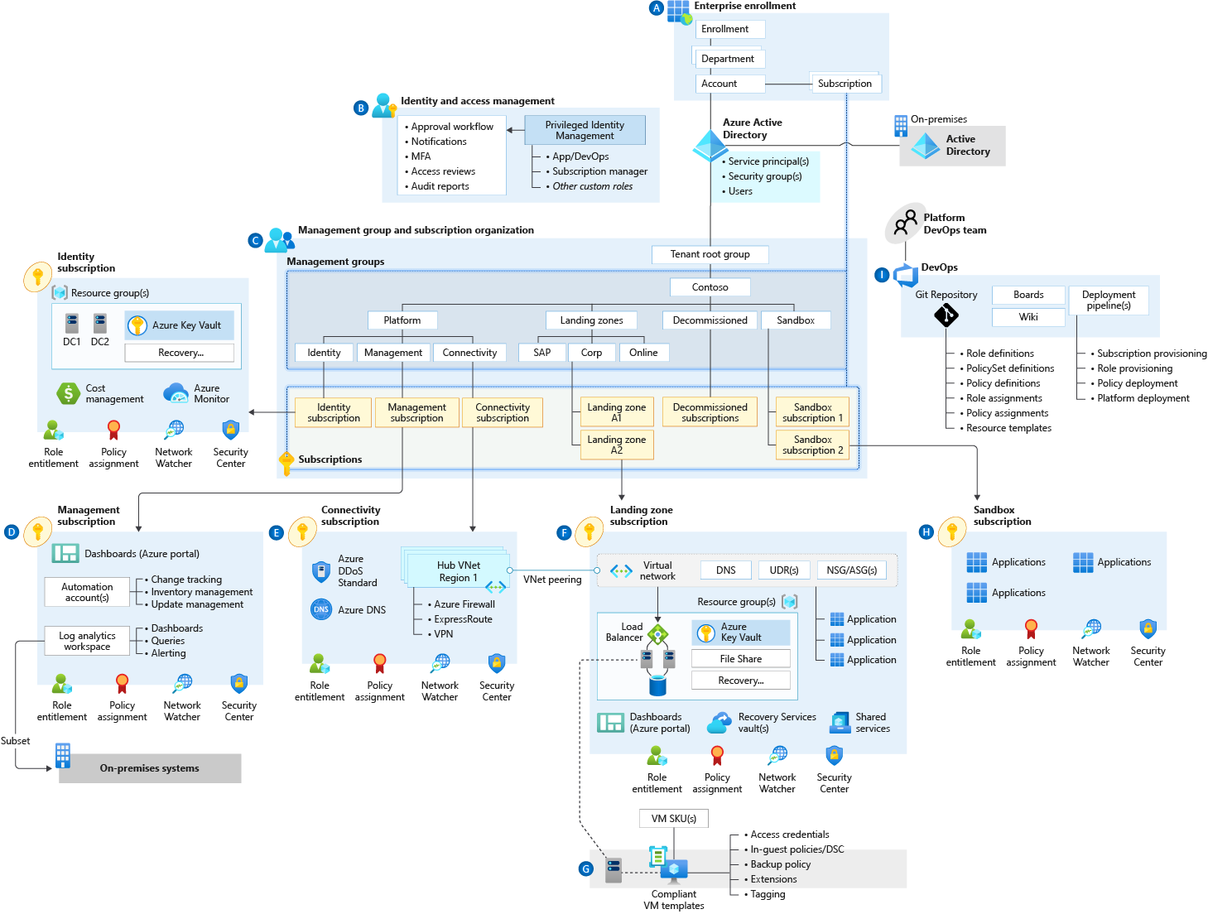
Azure landing zone conceptual architecture What does it represent?
Target end-state for most organizations
Scaled-out and mature environment
Customer and partner practices for environment design across Microsoft
Strong foundation for management, governance, and security processes
Notes:
Azure landing zone conceptual architecture
The destination (or target end-state) of the journey.
Scaled-out controls and architecture to enable customers to grow and innovate safely
Depending on the cloud operating model chosen, you may arrive at this destination quickly, or over time.
This may represent a subset of your estate, if you scale into enterprise operations or distributed operations
We are learning from engagements with customers and partners, codifying best practices guidance for the cloud adoption journey.
Let's dive into common starting points, and the typical phases of a cloud journey.

Slide 16
Start
Notes:
Now let's focus on how you progress towards the destination we’ve talked about.
As part of our guidance in the Cloud Adoption Framework, we’ve distilled down a wealth of experience and best practice into how to approach the implementation phase of a cloud environment.
We often see organizations at one of three points in their journey.

Slide 17

Assess each stage of your cloud journey
Start
Align
Enhance
Build a new environment
informed by best practices and proven architectures
Explore design areas to understand considerations and decisions for your journey
For your existing environments—
align to the architectures and guidance of Azure landing zones
Follow best practices guidance in Secure, Manage and Govern methodologies to continue to mature and evolve your Azure environments—and realize the value of cloud-native technologies
We have not deployed anything in Azure and want a start-to-finish plan based on best practices.
We have environments and landing zones already, but our requirements have changed, and we need to move towards a different type of architecture.
We have environments and landing zones already, using the CAF guidance, and want to continue improving the controls and configuration.
Notes:
Start – move towards accelerated architecture with accelerator
Align – review design areas and asses what parts need to be improved.
Enhance – what other processes can be built on top.
No matter where you are in your journey, this is the best practice-aligned architecture we want to implement.
Let's start on our cloud journey by looking at greenfield development.

Slide 18
What is "greenfield development"? Developing a new environment without dependencies
Beginning of your cloud adoption journey
Your new cloud environment
No production workloads are deployed
Environment can be overwritten and workloads moved without business impact
No business processes are impacted by changes to operations, controls, or access
We have not deployed anything in Azure and want a start-to-finish plan based on best practices.
Notes:
For most organizations, greenfield development is the beginning of the cloud adoption journey.
Read through the points on the slide to illustrate the general idea of "greenfield."
What about organizations looking for the fastest route to provision a landing zone—
with governance and compliance guardrails in place?

Slide 19
Azure landing zone accelerators Fastest path to deployment
Microsoft Azure portal implementation experience
Based on Azure landing zone conceptual architecture
Quickly implement scaled-out governance and security
Deploy tested, best-practice configurations for key governance policies, processes, and tools
Notes:
Azure landing zone accelerators are a ready-made deployment experience for organizations where conceptual architecture fits with the operating model and resource structure you plan to use.
Azure-portal-based deployment to provide a full implementation of the conceptual architecture, along with key governance elements such as management groups and policies.
Let's look in detail at how accelerators can speed up your deployment experience.

Slide 20
Azure landing zone accelerators Accelerate your customer value
What if we could reach customer value at pace?
Typical project engagements to design and build an Azure environment can run for 3-4 months, at considerable cost.
Much resource investment can be in developing implementation artifacts, implementation engineer time, and project management
In an increasingly large portion of cases, the outcomes look relatively similar (+/- a few percentages for low level customizations)
Notes:
Implementations of cloud environments can last multiple months, requiring several technical resources to complete. What if there were a way to accelerate this process?
But what we observe from a number of projects is the outcome is often relatively similar, with common implementation patterns aligned to the guidance and conceptual architecture we include in the Cloud Adoption Framework.
That’s where the Azure landing zone accelerator might be a great tool to help achieve those outcomes.
It takes the recommendations from the conceptual architecture and design areas and brings them into an easy-to-use portal-based deployment experience to accelerate the journey towards a great cloud environment.
Let's look at how accelerators work to reach a scaled-out, feature-rich environment footprint—enabling faster innovation and adoption.

Slide 21
Azure landing zones Design areas
Azure billing & Active Directory tenant
Security
Identity & access management
Governance
ENVIRONMENT
COMPLIANCE
Resource organization
Management
Network topology & connectivity
Platform automation & DevOps
Notes:
Each different Azure landing zone implementation option provides a different path to deployment. Before choosing an implementation option, let’s review design areas
Enterprise enrollment: if you are making a commitment to use a specific amount of Azure, you'll want to consider how your EA enrollment is configured & ensure your Azure AD tenant is aligned.
Identity: Are you using your existing Azure AD tenant from Office 365 by applying RBAC? Or do you have deeper security requirements that require more considerations?
Resource organization: Get a jump on cloud governance by preparing for proper resource organization early. This includes things like naming, tagging, subscriptions, resource groups, and management groups. Good design now will make portfolio governance easier later
Network topology and connectivity are the two must have considerations. Until you understand how things connect to in the cloud & how people gain access, you can't really use the cloud
Business continuity and disaster recovery - BCDR provides the foundation for reliability and rapid recovery. BCDR isn't really a design area, its a discipline under CAF Manage. i don't generally talk to it as a pillar, even though its on the design areas page. if anything just a brief mention of it during the Operations baseline talking point.
Governance disciplines: Begin including the governance disciplines in every landing zone to get an early start on governance, security baseline, and compliance policies.
Deployment options: Azure landing zones provide a variety of deployment options to fit your operating model
Operations Baseline: Get a jump start on operations management (CAF Manage) by preparing each landing zone for visibility, operational compliance, and protect/recover processes.
Let's look at the core technical constructs your organization needs for successful Azure adoption.

Slide 22

Azure landing zones— Implementation options
Start small and expand
CAF Migration landing zone, CAF Foundation template, and Terraform modules
Build an initial governance foundation for low-risk assets
Understand business priorities and motivations
Validate desired cloud operating model
Define governance, security, and compliance
Support customer skilling requirements
Design Azure landing zones—based on design areas
Deploy workloads to Azure
Notes:
Whether you start with enterprise scale or start small and expand, we focus on core technical constructs that must be designed and developed within the context of your requirements to create compliant technical landing zone environments and the conditions for successful Azure adoption.
Identity and access management
Policy management
Management and monitoring
Network topology and connectivity
Shared services infrastructure
DevOps
How do we know when the customer might require landing zone customization?

Slide 23

When do you need customization?
In some scenarios, you can't use a ready-to-deploy implementation:
The implementation doesn’t represent how you operate services.
Your organization has specific controls you require for compliance.
The north star for Azure landing zones remains the conceptual architecture—which customers and partners can use to design and operate successful cloud environments.
We have recommended best practices guidance and tools—to help you deliver a customized experience to design and operate your environments.
Notes:
How do you know, as a customer, when you need customization?
With the first bullet, stress the scenarios when customers can't use a ready-to-deploy solution, and will need to customize their environment implementation
Emphasize the "target end-state" of the conceptual architecture as a signpost guiding customers towards successful design and operation of cloud environments.
What if you need a fully featured enterprise-scale implementation—with complete governance and management in place?

Slide 24
Azure landing zones— Enterprise-scale implementation options
Start with enterprise-scale
Enterprise-scale landing zone
Build a rich initial implementation of landing zones—with a fully integrated governance, security, and operations control plane
Understand your motivations and state of the current cloud platform
Validate your cloud operating model
Review your governance, security, and compliance requirements
Design Azure landing zones—based on design areas
Deploy workloads to Azure
Notes:
Enterprise-scale landing zones represent the outcome of implementation experience and best practices gathered from customers and partners.
It is the distillation of recommendations and learnings used to implement scaled out, mature environments for customers in a variety of industries.
Enterprise-scale landing zones are fully featured implementations that include all requirements in order to start at scale:
Identity
Management
Governance
Security
Networking
You're getting ready to deploy.
Let's look at options for third-party support for implementing partner landing zones or Terraform modules.

Slide 25




Azure landing zones— Partner and open-source implementation options
Partner landing zone
Validate partner offer
Understand partner approaches and solution
Validate cloud operating model
Review partner solution for governance, security, and compliance
Review partner design, based on design areas
Deployment options for partner landing zone
CAF Terraform modules
Build on existing terraform skills
Path for multicloud operating models
Design Azure landing zones, based on design areas
Enable the community with a set of sample reusable landing zones
Deploy workloads to Azure
Azure Region 1
hub-core-sec
hub-operations
Diagnostics Logging
Activity Logs
Log Analytics
Network Monitoring
AD Assessment
AD Replication
Agent Health Assessment
DNS Analytics
Key Vault Analytics
Security Center
Notes:
The Cloud Adoption Framework approaches cloud adoption as a self-service activity. The objective is to empower each team that supports adoption through standardized approaches.
How we shouldn’t assume that a self-service approach is the right fit for all adoption scenarios
Successful cloud adoption programs often involve at least one level of third-party support.
Many cloud adoption efforts require support from a systems integrator (SI) or consulting partner who provides services that accelerate cloud adoption.
Managed service providers (MSPs) provide enduring value by supporting landing zones and cloud adoption, but they also provide post-adoption operations management support.
Additionally, successful cloud adoption efforts tend to engage one or more independent software vendors (ISV) who provide software-based services that accelerate cloud adoption.
The rich partner ecosystems of SIs, ISVs, MSPs, and other forms of Microsoft partners have aligned their offerings to specific methodologies found in the Cloud Adoption Framework.
When a partner is aligned to the Ready methodology of this framework, they will likely offer their own Azure landing zone implementation option.
Alongside the Azure landing zone accelerator, start small and enterprise approaches the solutions available through partners are also fantastic options to help accelerate cloud adoption.
These offers can help organizations progress on their implementation journey, with the option to customize based on specific requirements.
Terraform is increasingly common in cloud implementations, so it was important for us to be able to offer a Terraform-based solution for customers who have made investments in the technology.
These implementations deliver the same outcomes as we’ve talked about throughout this presentation – helping organizations progress towards the conceptual architecture.
Now, let's look at a summary of deployment options for Azure landing zones.

Slide 26
Azure landing zones— Deployment options summary
Azure landing zone accelerator (default option)
Fastest path to the target architecture
Implements environmental design practices
Implements opinionated compliance design best practices
Alternative approaches for customization
Partner landing zones
Start small landing zones
Enterprise-scale landing zones
Third party landing zones
Created and customized by your implementation partner, or managed service partner
Customized to your operations and adoption plans
Evaluated against the conceptual architecture
Rapidly deploy environment design areas, but defer compliance design areas
Accelerates low-risk deployments, but increases time to compliance
Ideal for central IT and centralized operations, with controlled adoption flows
Rapidly deploy environment design areas, but defer compliance design areas
Accelerates low-risk deployments, but increases time to compliance
Ideal for central IT and centralized operations, with controlled adoption flows
Start small and enterprise-scale Azure landing zone approaches are available for third-party configuration tools, like Hashicorp Terraform
Notes:
Summarize the slide, and provide a recap of the deployment options
Re-enforce the recommendation based on best practices that the customer should align to the conceptual architecture.
Let's move on and look at the Align phase.

Slide 27
Align
Notes:
The Align stage of the customer journey is where we review design areas and assess what parts of our Architecture need to be improved.

Slide 28
What is "brownfield development"? Developing and deploying code in existing environments
Workloads are already in use in the cloud
Migration events have already executed
Users are accessing services within the environment
Production workloads are running
We have environments and landing zones already, but our requirements have changed, and we need to move towards a different type of architecture.
Notes:
In the alignment phase of the journey, we talk to customers who have existing investments in their Azure environment.
Maybe they started their journey with by starting small and expanding or only have environmental design area requirements to start but now have more compliance design areas that need to be addressed.
When a customer is in Brownfield development, they have preexisting resources of code with workloads running.
For customers in the Align phase of their cloud adoption, new requirements or business justification have been put in place to continue building toward the conceptual architecture.
Let's look at what a common approach to landing zone implementation looks like.

Slide 29
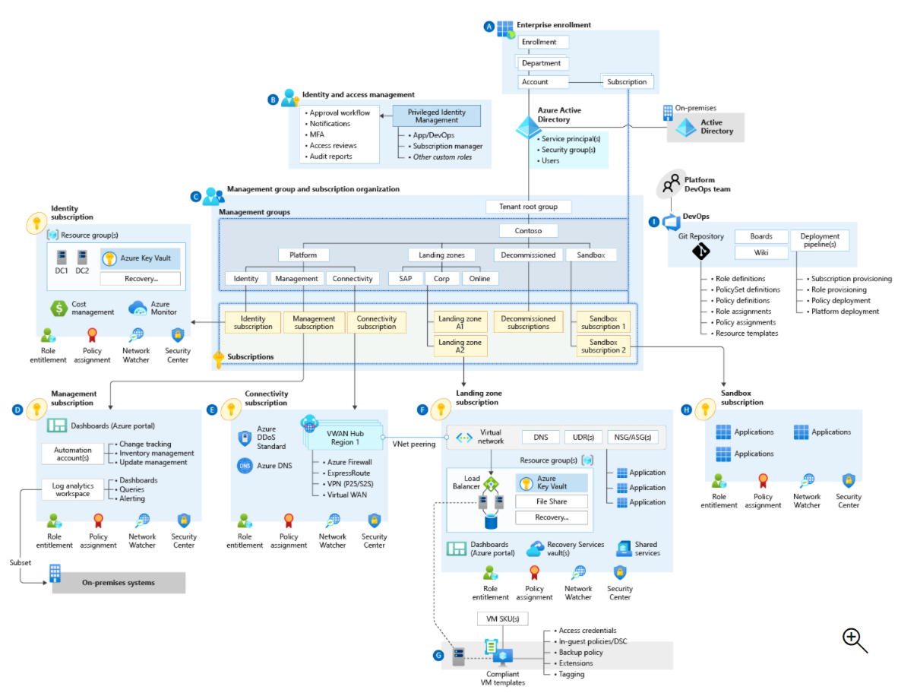
Common implementation approach
Target end-state:
Azure landing zones conceptual architecture
Check all boxes
Azure billing and AD tenant
Identity and access management
Network topology and connectivity
Resource organization
Governance
Management
Security
Platform automation and DevOps
Check few boxes
Check all boxes
Iterate and check
Small implementation
Notes:
With the target end-state in mind, we recommend a common, unified approach to landing zone implementation.
Progressing to the target end-state [Azure landing zones conceptual architecture]
All the onramps lead to the same freeway (ALZ conceptual architecture)
Your chosen design areas will affect your end-result, whether Start (greenfield development), Align (brownfield development involving refactoring), or Enhance (adding new controls or features to your environment).
Let's look at the stages or "onramps" guiding you to landing zone implementation, starting with the Align phase.

Slide 30
What is Align?
Start
Align
Enhance
Build a new environment
informed by best practices and proven architectures
Explore design areas to understand considerations and decisions for your journey
Align to the architectures and guidance of Azure Landing Zones if your organization has an existing environment
Follow best practices guidance in Secure, Manage and Govern methodologies—to continue to mature and evolve your Azure environments—and realize the value of cloud-native technologies
Provides guidance and best practices on modifying environments after an implementation
Enables customers to make technical changes to bring environments in line with conceptual architecture and design area recommendations
We have not deployed anything in Azure, and want a start-to-finish plan based on best practices.
We have environments and landing zones already, but our requirements have changed, and we need to move towards a different type of architecture.
We have environments and landing zones already, using the CAF guidance, and want to continue improving the controls and configuration.
Notes:
For organizations who have an existing environment that needs modification to align to the Azure landing zone target architecture and best practices (also referred to as brownfield).
Use the transition from brownfield guidance in order to understand the decision points and technical approach to refactoring environments to align with the guidance in the Ready methodology
What are some common scenarios when implementing cloud environments?

Slide 31
Implementing cloud environments— Common scenarios:
Cloud environment started out at a smaller scale—needs to adapt to accommodate growth
Internal demand requires scaling at speed
Business priorities or requirements have changed
New workload planned—changing requirements or environment design
Notes:
Here are some of the common scenarios for implementing cloud environments.
Review list of various scenarios that customers could encounter.
Let's look at what happens to your production environment when you move forward with your PoC to prod.

Slide 32
Moving from PoC to production— How does this affect your production environment?
Architecture and environment design that is used for experimentation often does not reflect how it should be designed for production
Fast experiments and proving theories are a fundamental benefit of elastic cloud services
It's common to see PoC environments organically grow into being used in production-like scenarios
Typically creates a decision point where the environment is depended on by users—but also needs aligning to best practices for production environment design
Notes:
When moving into your production environment from PoC, we tend to see some common events.
Let's look at some common examples of activities in the Align phase.

Slide 33


Align activities— Common examples:
Moving workloads into dedicated subscriptions
Expanding management group structure to scale the environment
Moving networking into dedicated subscriptions
Notes:
Here are some common examples of Align activities.
What does it look like in detail when your organization aligns to the conceptual architecture?

Slide 34

Aligning to the conceptual architecture— What does this look like for you?
The cloud services adoption journey
Continually check your path as a recommended best practice
You may reach a scale point—or a new business priority that requires changing your path
Evaluate the environment structure against the Azure Landing Zone conceptual architecture and determine the changes required
Focus on:
Azure Role Based Access Control (RBAC)
Policy—scope and change impact
Networking
Management group hierarchy
Management and security model—centralized or distributed
Notes:
Organizations seek to align to the target end-state of conceptual architecture—guided by common best practices along the way.
Let's continue our journey to the conceptual architecture and look at the Enhance phase next.

Slide 35
Enhance
Notes:
Landing zones are an important starting point – whether you’re starting from greenfield or brownfield.
One of the benefits of adopting cloud technologies is constant evolution and adding new features.
That means a perpetual opportunity to refine and expand your environment and operations as your scale or requirements grow.
That is where we see a lot of organizations looking to enhance their environment……

Slide 36
Azure landing zones— How are they related to the Govern, Manage, and Secure methodologies?
Continue your cloud adoption journey by defining processes for key operational compliance functions
Build on top of the landing zone foundations to enable your organization to scale out services and workloads to meet the needs of the business
Follow guidance and best practices within the Cloud Adoption Framework methodologies on:
Governance
Management
Security
Notes:
As part of the Cloud Adoption Framework, we have methodologies on governance, management, and security.
They don't only span technology considerations, but also include people and processes too, to provide a well-rounded set of guidance on successful cloud adoption.
Governance, management and security and considerations as part of the landing zone (as part of the design areas) so it’s a natural progress to enhancing these disciplines over time.
Let's see what compliant environments might look like in terms of governance, management, and security.

Slide 37

Compliance in an operational environment— What does this look like for you?
Govern
Manage
Secure
Define business risks based on data classification and application criticality
Convert risk decisions into policy statements to establish cloud adoption boundaries
Create policies to put guardrails in place to minimize business risks
Establish processes to monitor violations and compliance with defined corporate policies
Define criticality and relative business value of each service
Establish clear performance expectations and business interruption time/value metrics
Document, track and report on commitments to cost and performance
Integrate security insights into a risk management framework and digital initiatives
Integrate security insights and practices into business and IT processes, and integrate security disciplines together
Ensure organization can operate during attacks and rapidly regain full operational status
Notes:
What does achieving compliance in an operating environment across governance, management, and security considerations look like for your organization?
Review the main points of guidance under each methodology across Govern, Manage, and Secure.
Now, let's review the overall approach of each methodology, starting with Govern.

Slide 38


Govern methodology— Overview
Govern
Define corporate policy
Business risks
Document evolving business risks and the business’ tolerance for risk, based on data classification and application criticality
Policy and compliance
Convert risk decisions into policy statements to establish cloud adoption boundaries
Process
Establish processes to monitor violations and adherence to corporate policies.
Five disciplines of cloud governance
Cost management
Evaluate and monitor costs, limit IT spend, scale to meet need, create cost accountability
Security baseline
Ensure compliance with IT security requirements by applying a security baseline to all adoption efforts
Resource consistency
Ensure consistency in resource configuration. Enforce practices for on-boarding, recovery, and discoverability
Identity baseline
Ensure the baseline for identity and access are enforced by consistently applying role definitions and assignments
Deployment acceleration
Accelerate deployment through centralization, consistency, and standardization across deployment templates
Notes:
Corporate governance policies are formulated to detect potential problems.
The five disciplines of governance are actionable—and are rolled out in governance iterations.
Cost Management - Establish controls and processes to ensure proper allocation of cost across business units, implement cost guardrails, and analyze the cost of applications.
Security Baseline - Establish policies to protect your network, assets, and data residing on cloud provider platform(s).
Resource Consistency - Implement the foundation for governance best practices with correct resource organization.
Identity Baseline - Protect your data and assets in the cloud implementing identity management and access control.
Deployment Acceleration - Establish policies to govern asset configurations or deployments –manual or automated through DevOps best practices.
They help your organization manage risks—and create guardrails for your cloud adoption effort.
Using actionable, efficient, and comprehensive guidance, your organization can modernize, while achieving your business outcomes.
A cloud governance team is tasked with in an incremental process of mitigating risks to business processes and technology platform with minimal interruption to cloud adoption and innovation.
Now, let's review the overall approach of each methodology, continuing with Manage.

Slide 39

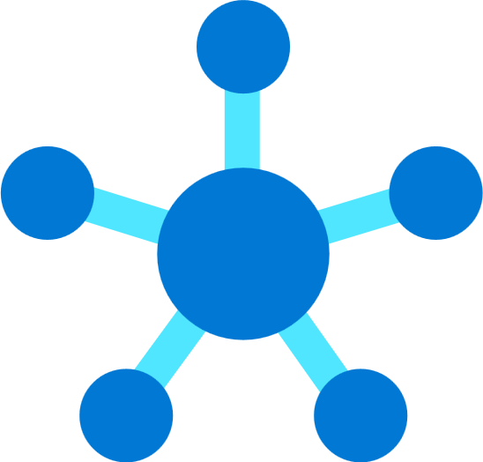
Manage methodology— Overview
Manage
Business alignment
Criticality
Document the criticality and relative business value of each workload.
Impact
Establish clear performance expectations and business interruption time/value metrics.
Commitment
Document, track and report on commitments to cost and performance.
Cloud operations disciplines
Inventory and visibility
Establish a defined inventory of assets. Develop visibility into the asset telemetry.
Operational compliance
Manage configuration drift and standards. Apply management automation and controls.
Protect and recover
Implement solutions to minimize performance interruptions and ensure rapid recovery when needed.
Platform operations
Customize operations to improve performance of the common platforms that support multiple workloads.
Workload operations
Understand workload telemetry. Align workload operations to performance and reliability commitments.
Notes:
Why we need a management baseline
A well-guided management baseline defines a set of cloud management tools and processes required to deliver your minimum commitment to operations management. It ensures a minimum set of tools and processes that should be applied to every asset in an environment.
Goals for management baseline
With management baselines, you can define the set of basic tools needed for managing operations around any Azure production environment
Focus on the minimum options and processes necessary instead of all the available options
Use the management baseline to apply resource consistency across different resources on the Azure platform
Why we need business alignments and commitments
To help support business operations, IT management delivers processes designed to minimize disruptions to those assets. When an organization moves to the cloud, management and operations shift to create an opportunity to develop tighter business alignment. Business alignment with cloud management is required to rethink commitments to operational management in partnership with the business.
The cloud management baseline consists of three basic disciplines for cloud resource management: inventory and visibility, operational compliance, and protection and recovery. These disciplines help organizations accelerate cloud management capabilities by focusing on the minimum options necessary instead of on all of the available options.
Platform specialization is an extension beyond the standard management baseline. Investing in ongoing operations of a specific workload is generally reserved for mission-critical workloads.
Platform specialization consists of a disciplined execution of the following processes in an iterative approach:
Improve the design of common systems (platforms) or specific workloads by considering best practices for architecture frameworks with Azure Architecture Frameworks
Minimize business interruptions with Azure Architecture Framework by improving systems designs with scalability, availability, resiliency, security, and management
Automate remediation and reduce the impact of interruptions; when resolution of technical debt isn't the desired approach, automated remediation is commonly the next step
Scale changes across the environment through the service catalogue, where these catalogues can help maximize adoption and minimize maintenance overhead of any optimized platform
Discover incremental improvements to address in the next pass of system design, automation, and scale
Workload specialization is similar in execution to platform specialization. But unlike common platforms, the specialization required by individual workloads often doesn't scale. When workload specialization is required, operational management commonly evolves beyond a central IT perspective. Invest in ongoing operations of a shared platform to distribute the investment across multiple workloads.
Workload specialization often triggers a cultural change in traditional IT build processes that focus on delivering a management baseline, enhanced baselines, and platform operations.
Apply best practices for improving the resiliency and design of a specific system with Azure Architecture Frameworks
Get the flexibility of advanced monitoring of options for monitoring performance, availability, usage, and dependencies
Operational tasks shift to an application-development or business-unit organization
Application insights—to get deep insights on the specific workload around performance, availability, usage, and dependencies—are required to provide clear workload operations
Now, let's finish our review of each methodology, ending with Secure.

Slide 40


Secure methodology— Overview
Secure
Business alignment
Risk insights
Integrate security insights into risk management framework and digital initiatives.
Security integration
Integrate security insights and practices into business and IT processes and integrate security disciplines together.
Business resilience
Ensure organization can operate during attacks and rapidly regain full operational status.
Security disciplines
Access control
Establish Zero Trust access model to modern and legacy assets using identity & network controls.
Security operations
Detect, respond, and recover from attacks; hunt for hidden threats; share threat intelligence broadly
Asset protection
Protect sensitive data and systems. Continuously discover, classify & secure assets.
Security governance
Continuously identify, measure, and manage security posture to reduce risk & maintain compliance
Innovation security
Integrate security into DevSecOps processes. Align security, development, and operations practices.
Notes:
Security is top-of-mind for most organizations today, and should be at the center of safe, secure cloud adoption.
The Cloud Adoption Framework guidance for security integrates business requirements with technology decisions and processes.
Business alignment
Risk insights
Security integration
Business resilience
Disciplines of security
Access control
Security operations
Asset protection
Security governance
Innovation security
Let's complete the session, and look at resources that are available to help you on your cloud journey.

Slide 41
Resources for deploying cloud-ready environments
Read the Azure landing zones documentation
Use guided technical documentation to choose the best landing zone option for your organization
Implement enterprise-scale landing zones in Azure—using GitHub resources for implementation guidance
Find your partner to support your organization's Azure landing zone implementation
Notes:
What resources are available to guide you and your organization in designing and building your solution offerings?
Review the next steps customers can take to read documentation on Azure landing zones and find partner solutions for landing zone implementation.
Thank you!

Slide 42
Thank you
Notes:
Thank You

